Slide 1
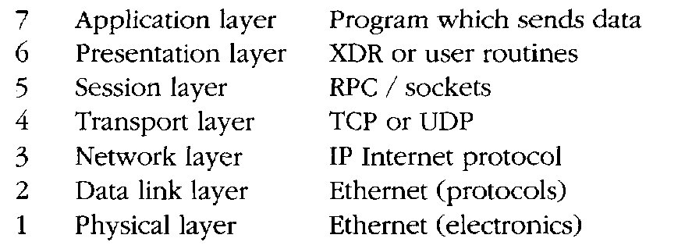
The OSI Model
The International Standards Organization (ISO) has defined a standard model for describing communications across a network, called the OSI model, for Open Systems Interconnect (reference model).

Slide 2
Cables and Interface Technologies
Different vendors have invested in different networking technologies, with different Media Access Control (MAC) specifications
• Bus/Ethernet approach: In the Ethernet bus approach, every host is connected to a common cable or bus. Only one host can be using a given network cable at a given instant.
It is like a conference telephone call: what goes out onto a network reaches all hosts on that network (more or less) simultaneously, so everyone has to share the line by waiting for a suitable moment to say something.
Ethernet is defined in the IEEE 802.3 standard documents. An Ethernet network is available to any host at any time, provided the line isn't busy. This is called CSMA/CD, or Carrier Sense Multiple Access/Collision Detect
• Token ring/FDDI approach: in the token ring approach, hosts are coupled to hubs or nodes, each of which has two network interfaces, and the hosts are connected in a unidirectional ring.
The token ting is described in IEEE 802.5.

Slide 3
A common token ring based interface in use today is the optical FDDI (Fiber Distributed Data Interface). Token rings can pass 16 Mbits/sec, with packet sizes of 18 kilobytes. The larger packet sizes are possible, since there is no risk of collisions.
• ATM: Asynchronous Transfer Mode technology [18] is a high capacity transmission technology developed by telephone companies to exploit existing copper telephone networks.
Current ATM implementations use 48-byte cells with 5 bytes of routing information. The cells are of a fixed length, allowing predictable switching times, and each cell has enough information to route it to its destination
ATM is believed to be able to reach transfer rates as high as 10 Gbits/sec.

Slide 4
Connectivity
The cables of the network are joined together in segments by hardware which makes sure that messages are transmitted from cable segment to cable segment in the right direction to reach their destinations.
A host which is coupled to several network segments and which forwards data, from one network to another is called a router. Routers not only forward data,
but they prevent the spread of network messages which other network segments do not need to know about.
A bridge is a hardware device which acts like a filter on busy networks. A bridge separates two segments of the same cable.
A repeater is an amplifier which strengthens the network signal over long stretches of cable.
Switched networks are immune to spies, net-sniffing or network listening devices. A switch performs many of the tasks of a router, and vice versa.

Slide 5
Protocols and Encapsulation
On a network, protocols are required to make sure that data are understood, not only by the receiver, but by all the network hardware which carry them between source and destination.
The data are wrapped up in envelope information which contains the address of the destination. Wrapping data inside envelope information is called encapsulation

Slide 6
NT supports three network protocols, running on top of Ethernet:
• NETBEUI: NETBIOS Extended User Interface, Microsoft's own network protocol. This was designed for small networks and is not routable. It has a maximum limit of 20 simultaneous users, and is thus hardly usable.
• NWLink/IPX: Novell/Xerox's IPX/SPX protocol suite. Routable. Maximum limit of 400 simultaneous users.
• TCP/IP: Standard Internet protocols. The default for NT 4 and Unix-like systems. Novell Netware and Apple Macintosh systems also support TCP/IP. There is no in-built limit to the number of simultaneous users.

Slide 7
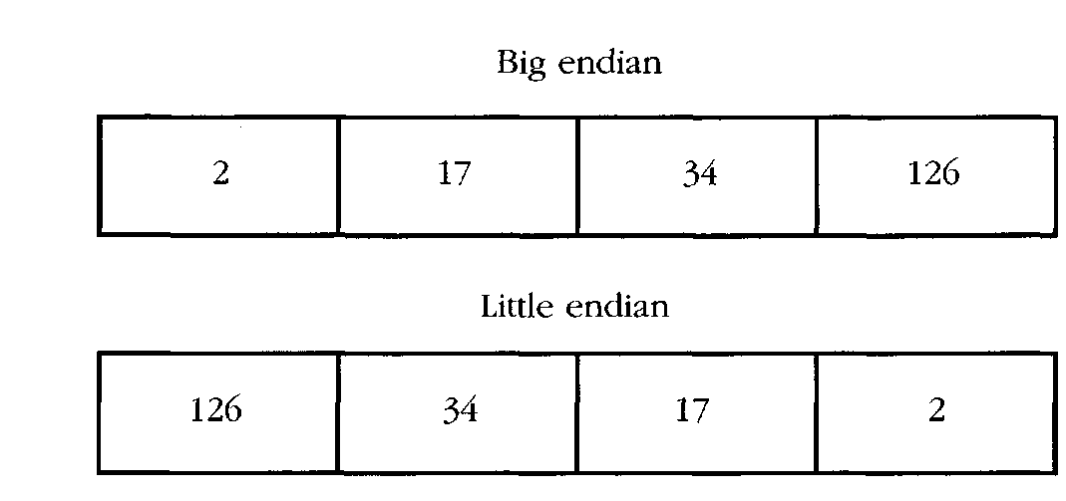
Data Formats
There are many problems which arise in networking when hardware and software from different manufacturers have to exist and work together.
Byte ordering sometimes has to be specified when compiling software. The representation of the number 34,677,374 has either of these forms

Slide 8
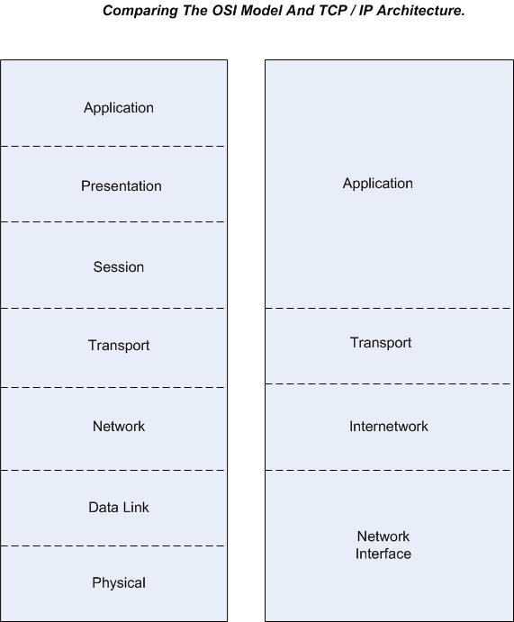

Slide 9
Internet Protocol
The IP in TCP/IP
IP is the network layer
  packet delivery service (host-to-host).
  translation between different data-link protocols.

Slide 10
IP Datagrams
An IP packet is called a datagram
IP provides connectionless, unreliable delivery of IP datagrams.
  Connectionless: each datagram is independent of all others.
  Unreliable: there is no guarantee that datagrams are delivered correctly or even delivered at all.

Slide 11
IP Addresses
IP addresses are not the same as the underlying data-link (MAC) addresses.
Why ?

Slide 12
IP Addresses
IP is a network layer - it must be capable of providing communication between hosts on different kinds of networks (different data-link implementations).
The address must include information about what network the receiving host is on. This is what makes routing feasible.

Slide 13
IP Addresses
IP addresses are logical addresses (not physical)
32 bits.
Includes a network ID and a host ID.
Every host must have a unique IP address.
IP addresses are assigned by a central authority (American Registry for Internet Numbers for North America).
IPv4 (version 4)

Slide 14
The four formats of IP Addresses
Class
A
0
NetID
HostID
B
10
NetID
HostID
C
110
NetID
HostID
D
1110
Multicast Address
8 bits
8 bits
8 bits
8 bits

Slide 15
Class A
128 possible network IDs
over 4 million host IDs per network ID
Class B
16K possible network IDs
64K host IDs per network ID
Class C
over 2 million possible network IDs
about 256 host IDs per network ID

Slide 16
Network and Host IDs
A Network ID is assigned to an organization by a global authority.
Host IDs are assigned locally by a system administrator.
Both the Network ID and the Host ID are used for routing.

Slide 17
IP Addresses
IP Addresses are usually shown in dotted decimal notation:
1.2.3.4 00000001 00000010 00000011 00000100
cs.rpi.edu is 128.213.1.1
10000000 11010101 00000001 00000001
CS has a class B network

Slide 18
Host and Network Addresses
A single network interface is assigned a single IP address called the host address.
A host may have multiple interfaces, and therefore multiple host addresses.
Hosts that share a network all have the same IP network address (the network ID).

Slide 19
IP Broadcast and Network Addresses
An IP broadcast addresses has a host ID of all 1s.
IP broadcasting is not necessarily a true broadcast, it relies on the underlying hardware technology.
An IP address that has a host ID of all 0s is called a network address and refers to an entire network.

Slide 20
Subnet Addresses
An organization can subdivide it’s host address space into groups called subnets.
The subnet ID is generally used to group hosts based on the physical network topology.
10
NetID
SubnetID
HostID

Slide 21
Subnetting
router
Subnet 1
128.213.1.x
Subnet 2
128.213.2.x
Subnet 3
128.213.3.x

Slide 22
Subnetting
Subnets can simplify routing.
IP subnet broadcasts have a hostID of all 1s.
It is possible to have a single wire network with multiple subnets.

Slide 23
Mapping IP Addresses to Hardware Addresses
IP Addresses are not recognized by hardware.
If we know the IP address of a host, how do we find out the hardware address ?
The process of finding the hardware address of a host given the IP address is called
Address Resolution

Slide 24
Reverse Address Resolution
The process of finding out the IP address of a host given a hardware address is called
Reverse Address Resolution
Reverse address resolution is needed by diskless workstations when booting (which used to be quite common).

Slide 25
ARP
Arp Arp!
The Address Resolution Protocol is used by a sending host when it knows the IP address of the destination but needs the Ethernet (or whatever) address.
ARP is a broadcast protocol - every host on the network receives the request.
Each host checks the request against it’s IP address - the right one responds.

Slide 26
ARP (cont.)
ARP does not need to be done every time an IP datagram is sent - hosts remember the hardware addresses of each other.
Part of the ARP protocol specifies that the receiving host should also remember the IP and hardware addresses of the sending host.

Slide 27
ARP conversation
HEY - Everyone please listen!
Will 128.213.1.5 please send me his/her Ethernet address?
not me
Hi Green! I’m 128.213.1.5, and my Ethernet address is 87:A2:15:35:02:C3

Slide 28
RARP conversation
HEY - Everyone please listen!
My Ethernet address is 22:BC:66:17:01:75.
Does anyone know my IP address ?
not me
Hi Green! Your IP address is 128.213.1.17.

Slide 29
Services provided by IP
Connectionless Delivery (each datagram is treated individually).
Unreliable (delivery is not guaranteed).
Fragmentation / Reassembly (based on hardware MTU).
Routing.
Error detection.

Slide 30
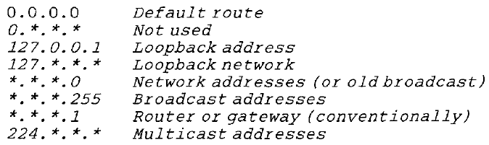

Slide 31
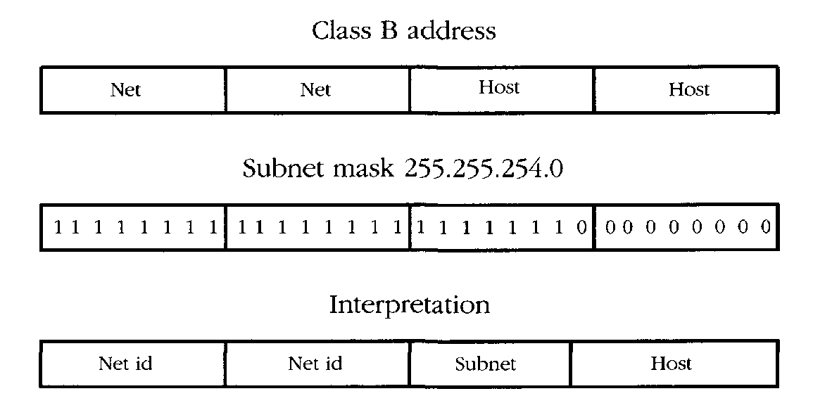
Example of how the subnet mask can be used to double up the number of hosts per
subnet by pairing host parts. The boundary between host and subnet parts of the address is moved one bit to the left, doubling the number of hosts on the subnets which have this mask

Slide 32
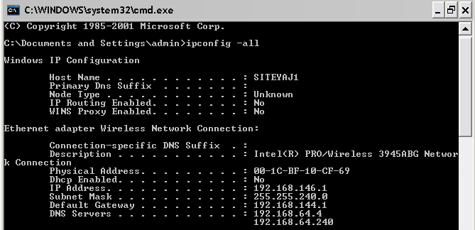

Slide 33
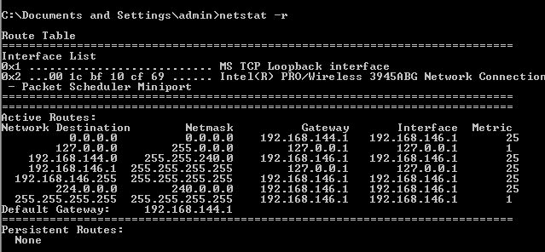
Routing
Unless a host operates as a router in some capacity, it only requires a minimal routing configuration. Each host must define a default route which is a destination to which outgoing packets will be sent for processing when they do not belong to the subnet. This is the address of the router or gateway on the same network segment.
route add default my-gateway-address 1
The default route can be checked using the netstat -r command

Slide 34
Network Analysis
A top down approach is useful for understanding network inter-relationships
• How does the network fit together? (What is its topology?)
• How many different subnets does the network have?
• What are their network addresses?
• Find the router addresses (the default routes) on each segment.
• What is the netmask?
• What hardware is there in the network? (Hosts, printers, etc.)
• Which function does each host/machine have on the network?
• Where are the key network services located?

Slide 35
Most newer network hardware supports some kind of querying using SNMP protocols
An overview of network services can sometimes be obtained using port-scanning software, such as nmap
We need to know hosts both from the viewpoint of hardware and software:
• What kind of machines are on the network? What are their names and addresses and where are they? Do they have disks. How big? How much memory do they have? If they are PCs, which screen cards do they have?
• How many CPUs do the hosts have?
• What operating systems are running on the network? MS-DOS, Novell, NT or Unix (if so, which Unix? GNU/Linux, Solaris, HPUX?)
• What kind of network cables are used? Is it thin/thick Ethernet? Is it a star net (hubs/twisted pair), or fibre optic FDDI net?
• Where are hubs/repeaters/the router or other network control boxes located? Who is responsible for maintaining them?
• What is the hierarchy of responsibility?

Slide 36
There is information about the local environment:
• What is the local time zone?
• What broadcast address convention is used? 255 or the older 0?
• Find the key servers on these networks:
- Where are the NFS network disks located? Which machine are they attached to?
- Which name service is in use (DNS, NIS or NIS plus)?
- Where is the inevitable WWW/http service? Who is running pirate servers?
Network Orientation
Familiarizing oneself with an organization's network involves analyzing the network's hosts and all of their inter-relationships.
The most obvious way to view an organization is by its logical structure.
This is usually reflected in the names of different machines and domains

Slide 37
Who do we call if the Internet connection is broken?
What service contracts exist on hardware
what upgrade possibilities are there on software?
What system is in use for making backups?
How does one obtain a backup should the need arise?
The Domain Name Service (DNS) is the Internet's primary naming service. It not only allows us to name hosts, but also whole organizations, placing many different IP addresses under a common umbrella.
The DNS is thus a hierarchical organization of machine names and addresses. Organizations are represented by domains and a domain is maintained either by or on behalf of each organization.

Slide 38
DNS – the Domain Name System
Which is easier to remember:
  www.swan.ac.uk or 137.44.1.20?
Names also provide transparency:
  eg can move www.swan.ac.uk to 137.44.1.21
Early days: hosts.txt
Lists all hosts and their IP addresses
Every night, each host fetches new copy from central location
OK for a few hundred machines
  More: bottleneck, single point of failure, clashes, …

Slide 39
DNS Servers
Primary only one
Many secondary

Slide 40
DNS essentials
RFC 1034, 1035, others
Maps hostnames to IP addresses (and back)
Also says where to deliver mail for a host
A hierarchical, domain-based naming scheme
  Domains responsible for managing subdomains
Distributed database system for implementing the scheme
  Basic data type is the Resource Record
A protocol for querying the database system
  Binary messages, UDP transport

Slide 41
Example: DNS as used by HTTP
Surf: http://www.swan.ac.uk/index.html
Browser extracts www.swan.ac.uk from URL, passes it to DNS client code
  (eg gethostbyname() call)
DNS client code sends query to DNS server
DNS server replies: 137.44.1.7
Web browser establishes TCP connection to 137.44.1.7 port 80
Every single time! Adds time to operation, sometimes long time...

Slide 42
The DNS Name Space
Over 200 Top Level Domains
  com, org, edu, net, ..., uk, nl, jp, cn, ...
Each domain controlled by a registrar, who assigns ownership of subdomains
  eg want hatsforcats.com ? Pay .com registrar $$$
Owner of a domain can then divide it further/sell subdomains/etc
  eg fluffy.hatsforcats.com
  eg ac.uk -> swan.ac.uk, -> cs.swan.ac.uk
Organisational boundaries, not physical networks

Slide 43
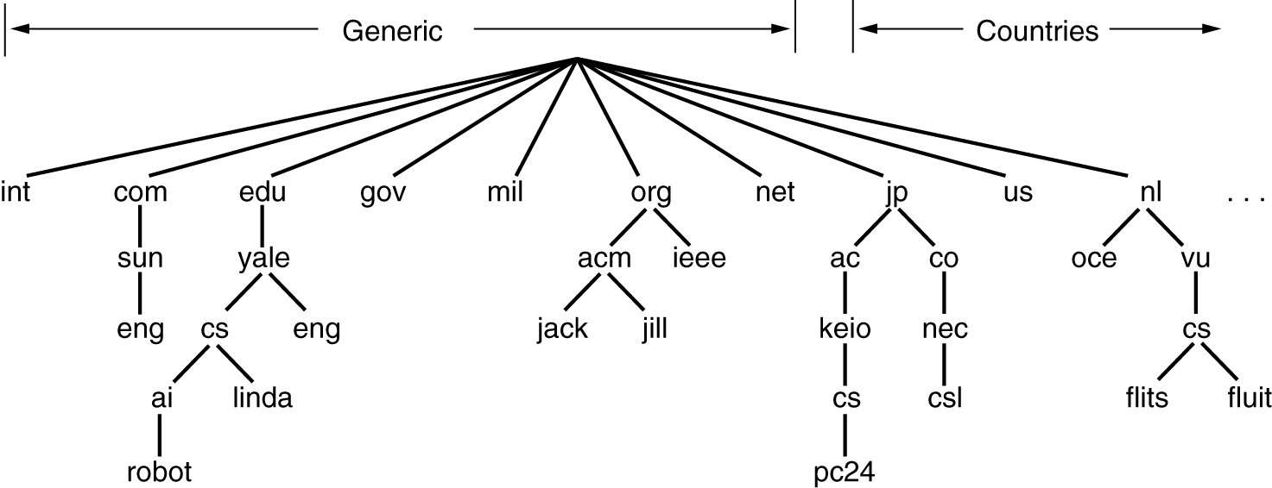
Part of the DNS Name Space

Slide 44
Services provided by DNS
Hostname IP resolution (and reverse)
Host aliasing
  eg, www.swan.ac.uk might really be called funky.swan.ac.uk
  then www.swan.ac.uk -> funky.swan.ac.uk -> 137.44.1.7
Mail server aliasing
  Where does email for webmaster@www.swan.ac.uk go?
    Might be funky.swan.ac.uk, but doesn't have to be
Load distribution
  Some sites use multiple redundant servers, return many IP addresses for one hostname
  Typically only first is used: DNS server rotates the list, so have round robin

Slide 45
Part of the DNS Server Hierarchy
Root DNS Servers
com servers
org servers
uk servers
ac.uk servers
w3c.org servers
yahoo.com servers
google.com servers
swan.ac.uk servers
cam.ac.uk servers

Slide 46
NSLOOKUP

Slide 47
Special Information
The domain name service identifies certain special hosts which perform services like the name service itself and mail-handlers (called mail exchangers).
These servers are identified by special records so that people outside of a given domain can find out about them. After all, the mail service in one domain needs to know how to send mail to a neighboring domain.
> set q=mx
> otherdomain.org
Server: mother.example.org
Address: 192.0.2.10
Non-authoritative answer:
otherdomain.org preference = 0, mail exchanger =
mercury.otherdomain.org
Authoritative answers can be found from:
otherdomain.org nameserver =mercury.otherdomain.org
otherdomain.org nameserver = delilah.otherdomain.org
mercury.otherdomain.org internet address = 158.36.85.10
delilah.otherdomain.org internet address = 129.241.1.99

Slide 48
Listing Hosts Belonging to a Domain
To list every registered Internet address and hostname for a given domain one can use the Is
command inside nslookup . For instance
> Is example.org
[mother.example.org]
example.org. server =mother.example.org
example.org. server =mercury.otherdomain.org
pc61 192.0.2.61
pc59 192.0.2.59
pc59 192.0.2.59
pc196 192.0.2.196

Slide 49
Changing to a Different Server
If we know the name of a server which contains authoritative information for a domain, we can tell ns lookup to use that server instead. In that way it might be possible to list the hosts in a remote domain and find out detailed information about it. At the very least, it is possible to find out about key records, like name servers and mail exchangers (MX). To change the server we simply type
> server new-server

Slide 50
Planning Network Resources
Mapping Out Services
Existing network services have to be analyzed, so that we know where we are starting from, and new networks need to be planned or extended.
Location can be performed by a visual inspection of the process tables, or from configuration files. There are tools for port scanning networks in order to locate services, e.g. the nmap program.
• How to choose the right hardware for the right job.
• Which hosts should be servers and for which services.
• How to make disks available to the network.
• How to share tasks between machines.
• How clock/time synchronization will work.

Slide 51
The efficiency of a network can be improved greatly by planning carefully how key networks services are organized: particularly file servers and name services, which form the basic infrastructure of a network. Here is a partial checklist:
• Which hosts keep the physical disks for NFS disk servers? It makes sense to keep all file services which use those disks on that same host. If the source data are on host A, then we run all file services for those data on host A, otherwise data will first have to be copied from A to B, over the network, in order to be served back over the network to host C, i.e. there will be an unnecessary doubling of traffic.
• Normally we shall want to use a powerful system for the servers which provide key disk and WWW services, since these are at the heart of network infrastructure. Other hosts depend upon these.
However, if resources are limited we might need to reserve the fastest host for running some especially heavy software. This has to be a site dependent calculation.

Slide 52
Uniform Resource Locators (URLs)
In a network the name of a partition ought to be a URL, i.e. contain the name of the host
Principle (One name for one object I) Each unique resource should have a unique name which labels it and describes its function.

Slide 53
Choosing Server-Hosts
Choosing the best host for a service is an issue with several themes. The main principles have to do with efficiency and security, and can be summarized by the following questions:
• Does traffic have to cross subnet boundaries?
• Do we avoid unnecessary network traffic?
• Have we placed insecure services on unimportant hosts?
Principle 11 (Inter-dependency) Avoid making one service reliant on another. The more independent a service is, the more efficient it will be, and the fewer possibilities there will be for its failure
Place all file servers which serve the same data on a common host, e.g. WWW, FTP and NFS serving user files. Place them on the host which physically has the disks attached. This will save an unnecessary doubling of network traffic and will speed up services. A fast host with a lot of memory and perhaps several CPUs
should be used for this

Slide 54
Distributed File Systems and Mirroring
The purpose of a network is to share resources amongst many hosts. Making files available to all hosts from a common source is one of the most important issues in setting up a network community. There are three types of data which we have to consider separately:
• Users' home directories.
• Software or binary data (architecture specific).
• Other common data (architecture unspecific).
How are network data shared? There are two strategies:
• Use of a shared file system (e.g. NFS or Novell Netware).
• Disk mirroring.

